Slide 1
COVID safe measures for Greater Sydney: social content
10 May 2021

Slide 2
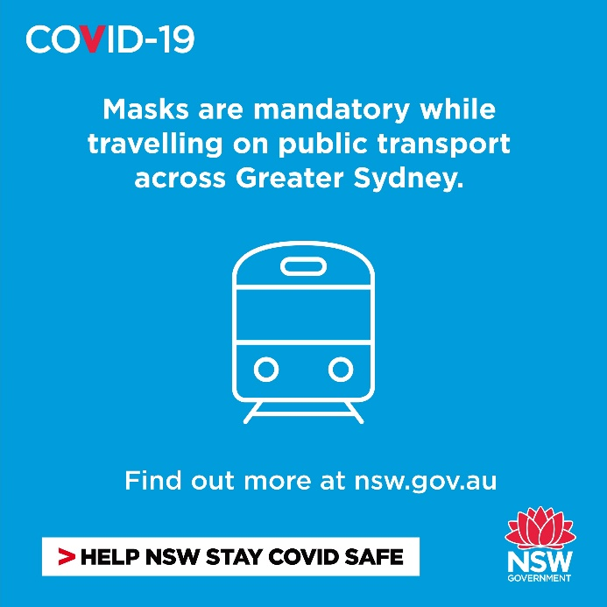
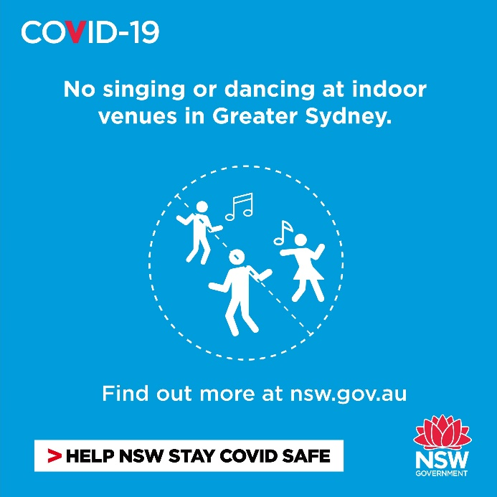
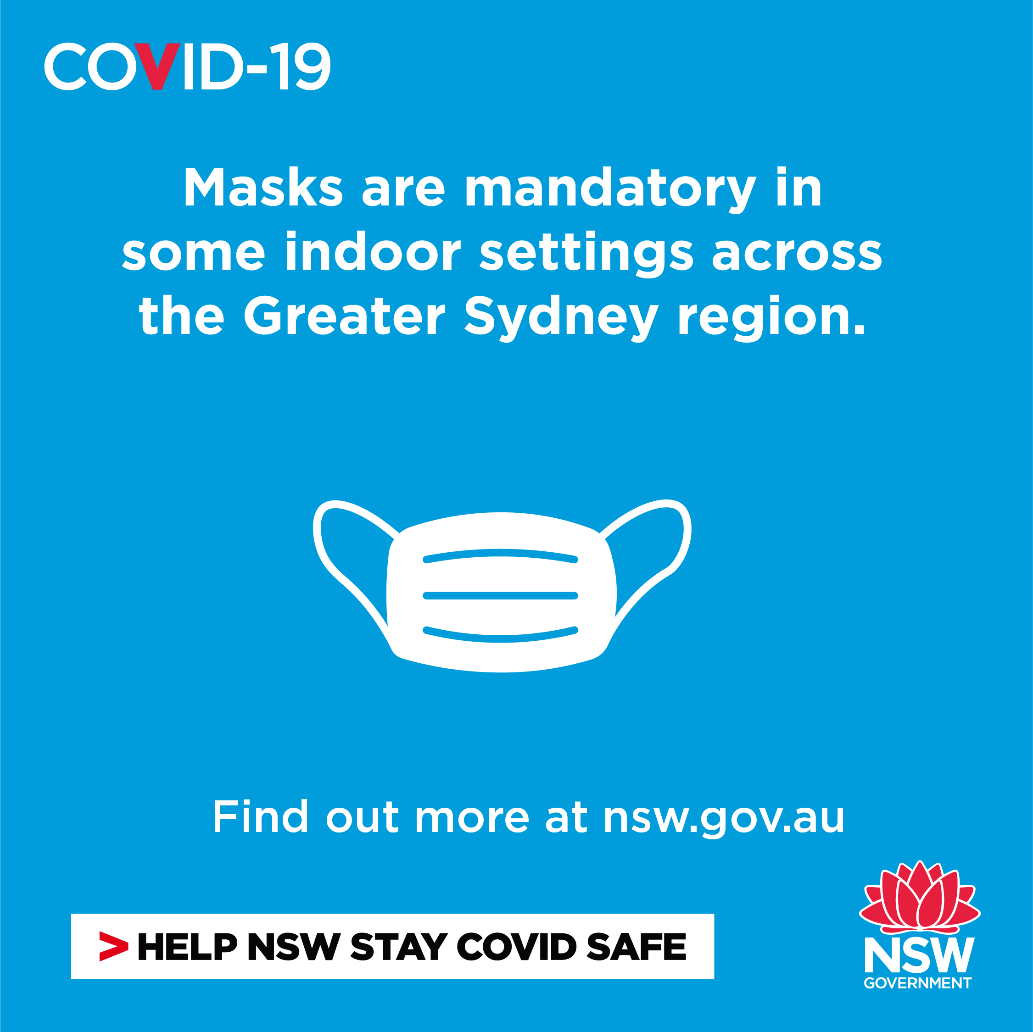
Greater Sydney COVID safe measures: social media content
Note: COVID safe measures are currently in place until 12:01am Monday 17 May
Post: Due to recent cases of COVID-19 community transmission, masks are mandatory while travelling on public transport in the Greater Sydney region including Wollongong, Central Coast and Blue Mountains. Learn more at nsw.gov.au
Post: Masks are mandatory while indoors at some public venues across the Greater Sydney region. This includes theatres, hospitals, and gaming areas in licensed premises. Face masks are also mandatory for front of house hospitality and retail staff. Learn more at nsw.gov.au
Post: Under the current measures, singing is not allowed at indoor venues and dancing is not allowed at any indoor hospitality venue or nightclub. Some exceptions apply for weddings and for performers in shows. Learn more at nsw.gov.au

Slide 3
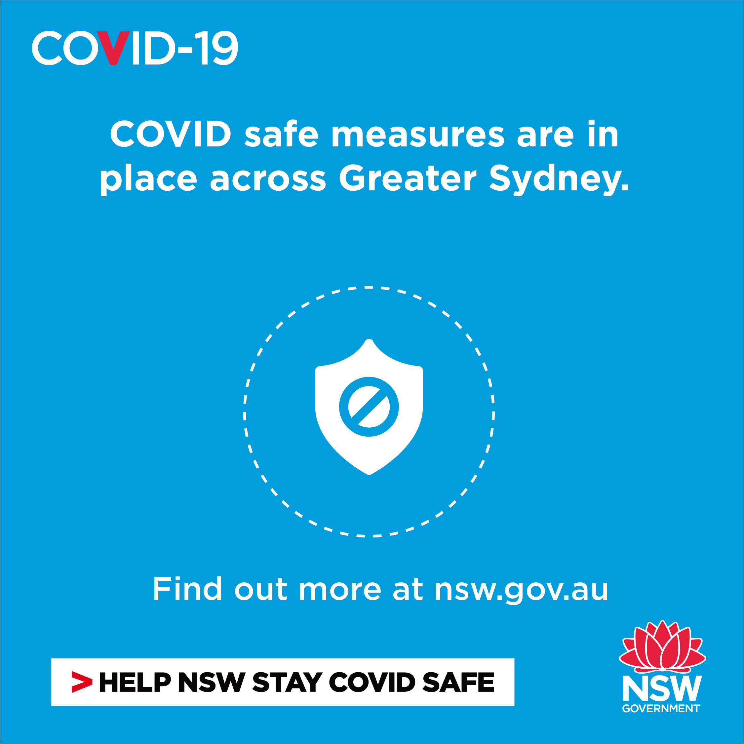
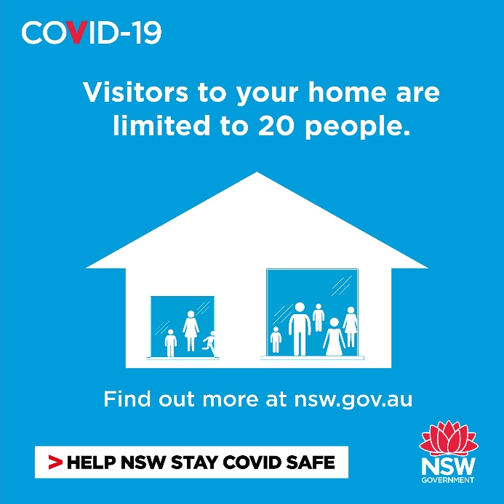
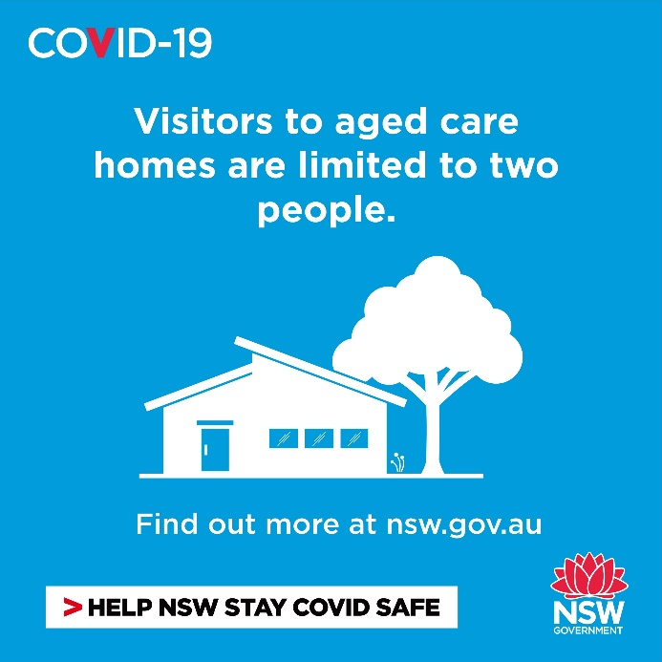
Greater Sydney COVID safe measures: social media content
Note: COVID safe measures are currently in place until 12:01am Monday 17 May
Post: COVID-19 measures apply in the Greater Sydney region, including Wollongong, Central Coast and Blue Mountains. This includes aged care, some indoor venues, hospitality venues and public transport. Find out more at nsw.gov.au
Post: Due to the recent cases of COVID-19 community transmission, the number of visitors to your home is limited to 20 people if you live in the Greater Sydney region, including Wollongong, Central Coast and Blue Mountains.
Post: COVID safe measures mean a maximum of two visitors per day at aged care homes. Individual homes may have further restrictions so best to check ahead before visiting. nsw.gov.au

