Slide 2

“Your present circumstances
don’t determine where you can go;
they merely determine where you start.”
- Nido Qubein

Slide 3

ACTIVITY 1 - Discussion in pairs
  What is community inclusion?
  Building capacity
  Challenges and barriers to participation?
  Having good mental health?
  Health and well-being impacts
  of loneliness
  Importance of outreach and engagement
EMPOWERMENT

Slide 4
Learning outcome:
Awareness of self-direction as a key recovery tool
What you will learn:
  Decision making
  Types of decision making
  Self-advocacy
  Self-directed care
  Choice and control
    Digital literacy

Slide 5
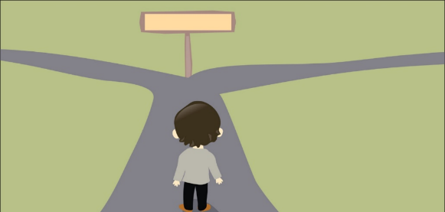
What is decision-making?
I guess the huge difference is that other people, places and things controlled my life. Recovery has been about developing the tools and skills that enabled me to reclaim control of my life. It’s about being in the driver’s seat.
- Gwen Scotman, 2014
EMPOWERMENT

Slide 6
NOTHING ABOUT ME, WITHOUT ME
EMPOWERMENT

Slide 7
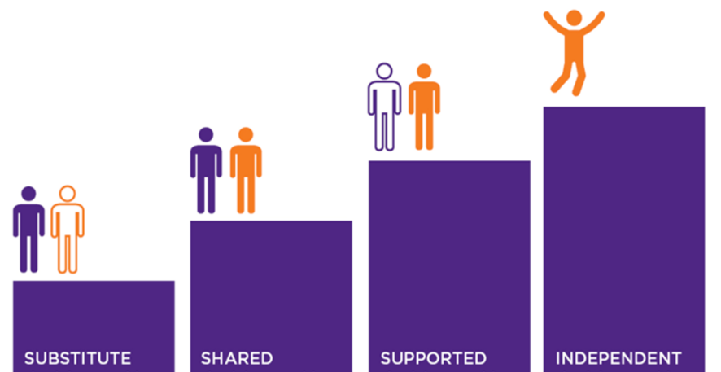
Types of decision making
EMPOWERMENT

Slide 8
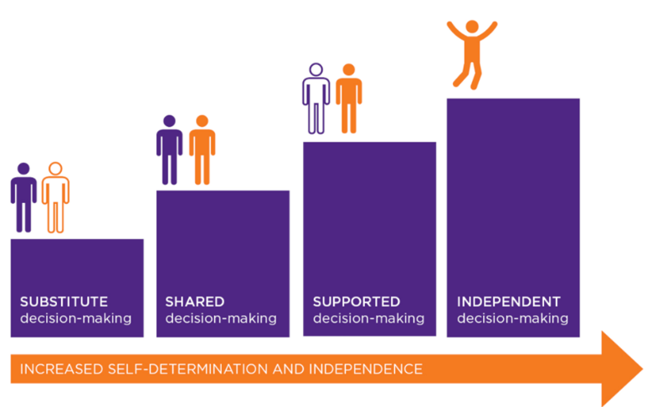
Decision-making continuum
What might influence where a person with a mental health condition sits on this continuum at any time?
EMPOWERMENT

Slide 9
ACTIVITY 2 – Advocacy within a recovery paradigm
Self-advocacy
Speaking on your own behalf and
in your own interests
Self-directed advocacy
Advocacy
If and when the
person chooses
not to self-advocate
at that time
When advocacy is undertaken by a party other than the person and is not directed by the person
EMPOWERMENT

Slide 10
Self-directed care
hope and personal control
self-belief
own agency and purpose
the person’s own efforts
other people important in the person’s life
positive risk-taking
offering tools
self-determination and self-advocacy
choice and control
EMPOWERMENT

Slide 11


Choice and control
freedom to plan and be in control of your life
information to make choices
knowing more about yourself and what you want
dreams and goals and going after them
authority and control over your resources
making your own decisions
support to live & participate in your own community
real access to education, employment, housing etc

Slide 12

Digital literacy
Key to making decisions and choices is access
to information and support
The world today requires digital literacy along
with language, literacy and numerical skills
Digital literacy is increasingly required of people
and their supporters
Digital natives and digital refugees
Develop digital literacy skills and be a
digital literacy mentor
EMPOWERMENT

Slide 13
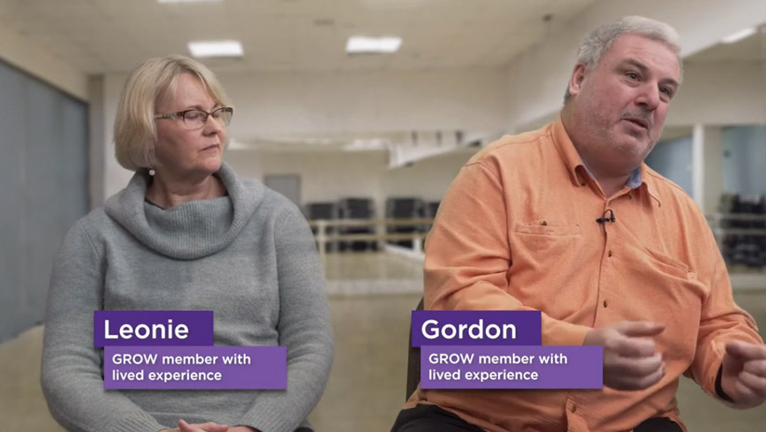
ACTIVITY 3: Video – Empowerment
EMPOWERMENT

Slide 14
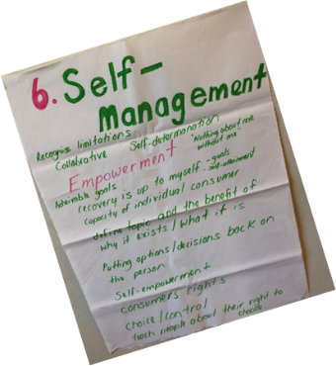
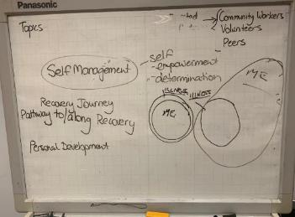
WHAT HAVE I LEARNED?
Awareness of self-direction as a key recovery tool

