Slide 2

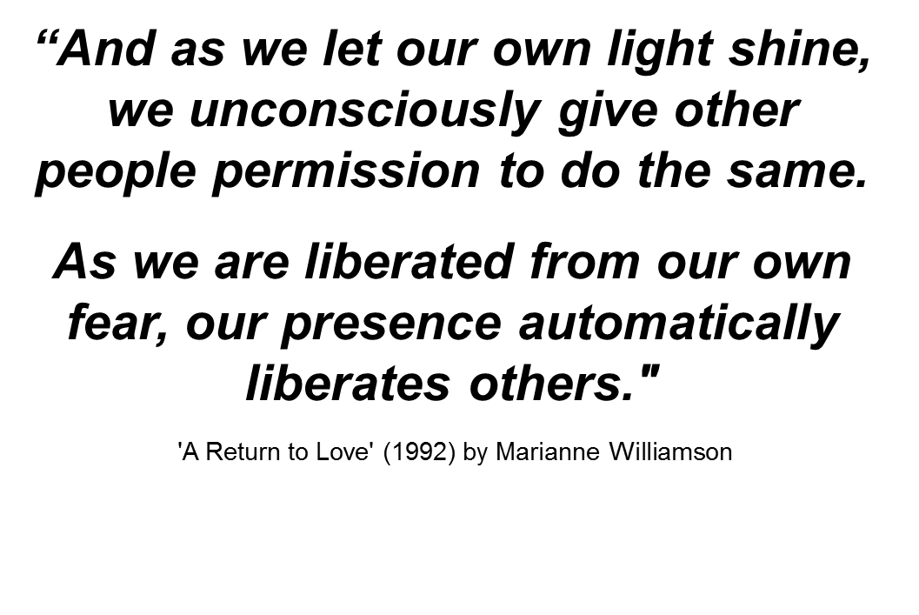
RECOVERY

Slide 3

ACTIVITY 1 - What does this image mean to you?
WHAT IS RECOVERY?

Slide 4
Learning outcome:
Understand the importance of hope, purpose and meaning when healing from the impacts of a mental health condition
What you will learn:
  A word about language
  Personal recovery & medical recovery
  What is recovery (CHIME – 5 elements of recovery)
  Life/goal planning (person-centred recovery
  planning
  Rights

Slide 5
Words and language
Call me a consumer
Call me Sue
I like participant
What is your preferred language
WHAT IS RECOVERY?

Slide 6
What is personal recovery?
It is designed and directed by the individual
It is about working towards a quality life:
having hope
a life with meaning and purpose
being empowered
being valued by myself and other people
It is a ‘journey’, not a ‘destination’
WHAT IS RECOVERY?

Slide 7

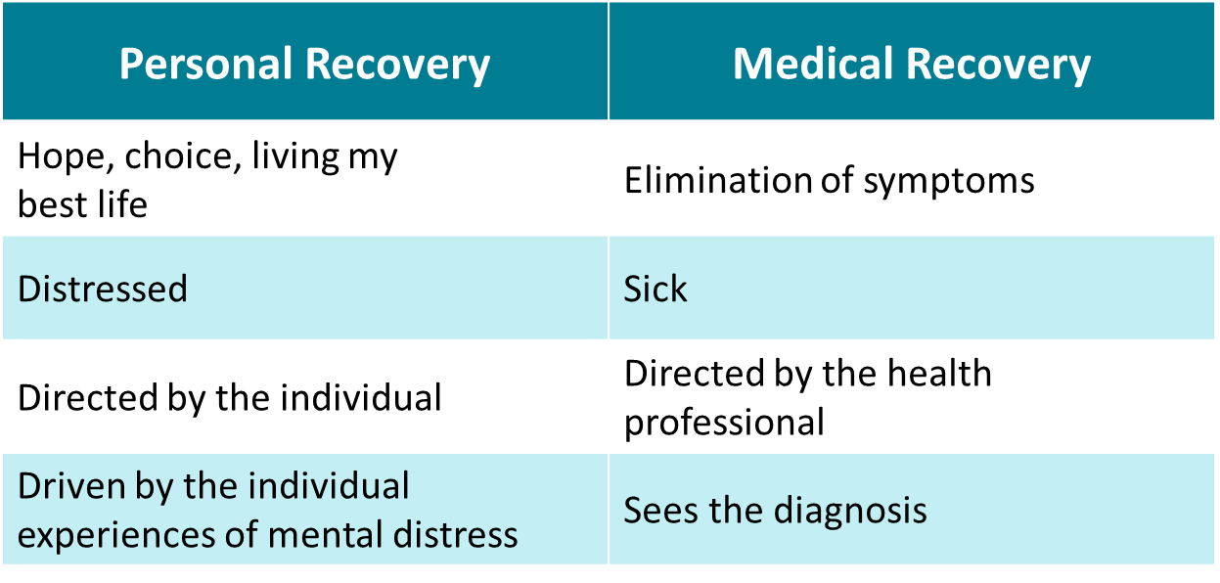
SUPPORTING COMMUNITY CONNECTION: What is recovery?

Slide 8
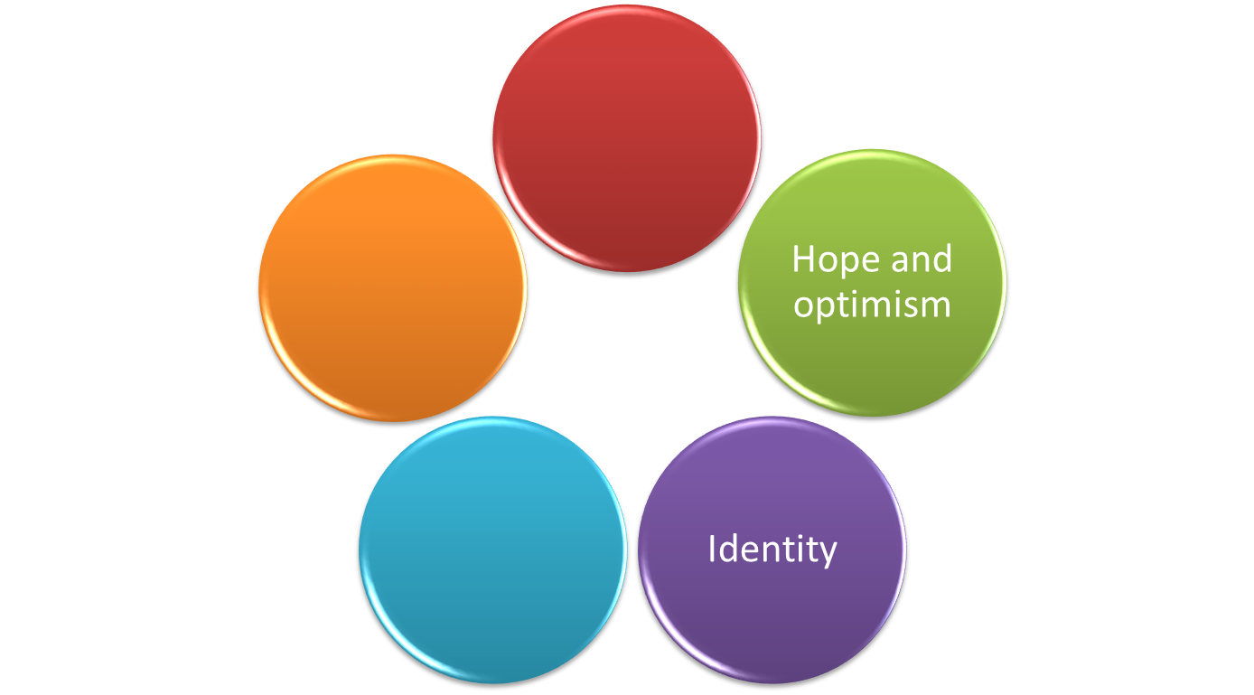
Common model of recovery - CHIME
Connectedness
Empowerment
CHIME
Meaningful life

Slide 9

Life/goal planning (person centred approach)
Looks at all aspects of the person’s life to identify needs and priorities, including:
  Environment
  Natural supports
Puts the person at the centre of all decisions making that affects them giving
  Choice and control
  Hope and empowerment
  Voice and participation

Slide 10

All people living with mental health conditions have the right to:
An adequate standard of living
The enjoyment of the highest attainable standard of physical and mental health
To exercise legal capacity and the right to personal liberty and the security of person
Freedom from torture or cruel, inhuman or degrading treatment of punishment and from exploitation violence and abuse
Live independently and be included in the community

Slide 11
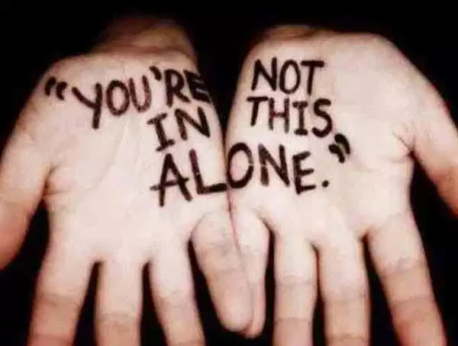
Be authentic – Walking the Talk
Be genuine, warm and real
Be self-aware
Be trustworthy
Value others
Be approachable and open
Be present and mindful
Be constant and resilient
Be available and willing to share
Be self-reflective
Create safe spaces

Slide 12
ACTIVITY 2 - What can you do to help reality meet expectations?
WHAT IS RECOVERY?

Slide 13
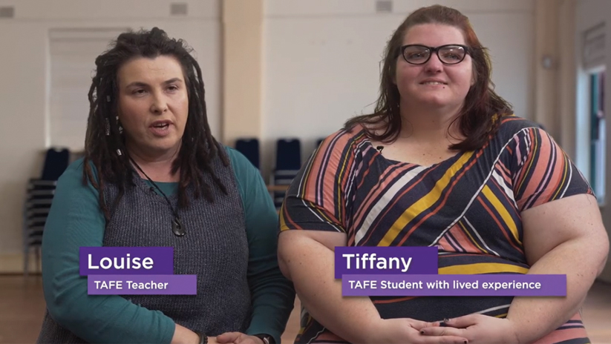
ACTIVITY 3: Video – What is Recovery?
SUPPORTING COMMUNITY CONNECTION

Slide 14
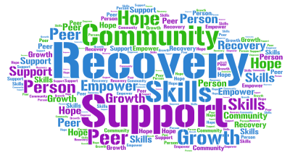
WHAT HAVE I LEARNED?
Understand the importance of hope, purpose and meaning when healing from the impacts of a mental health condition

